Slide 1


BVRIT HYDERABAD College of Engineering for Women
Department of Computer Science And Engineering
HOPPING ASSASSINS
TEAM :15
P . Rithvika (22WH5A0509)
P. Saivinaya (22WH5A0510)
T . Abhinaya ( 22WH5A0511)
K . Sushma (22WH5A0512)
04/02/2023
Department of CSE
‹#›

Slide 2
Agenda
Problem statement
Packages
Modules
Implementation
Contribution of team
Main window
Game window
Final window
Reference
04/02/2023
Department of CSE
‹#›
Notes:
‹#›

Slide 3
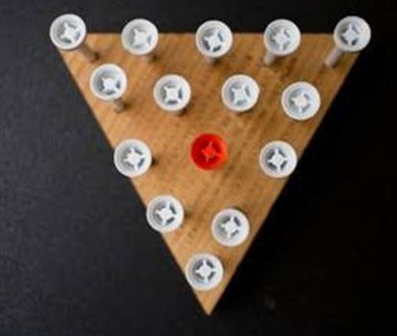
Problem Statement
Description:
The program is to read an initial board configuration . This configuration is described by 1511.
1 indicates that a peg is present in the hole and 0 indicates empty hole.
Puzzle starts with 14 pegs and 1 empty hole.
The aim is to compute and print the sequence of moves which will terminate all pegs and leaving one peg on the board.
04/02/2023
Department of CSE
‹#›

Slide 4
Packages
Tkinter: Tkinter is the standard GUI library for Python. Python when combined with Tkinter provides a fast and easy way to create GUI applications. Tkinter provides a powerful object-oriented interface to the Tk GUI toolkit.
Pygame: It is a cross-platform set of python modules which is used to create video games.
It consists of computer graphics and sound libraries designed to be used.
04/02/2023
Department of CSE
‹#›

Slide 5
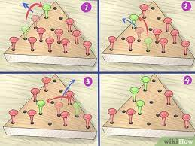
Modules
pygame.quit()
Pygame.display.update()
Mixer
Pygame.init()
04/02/2023
Department of CSE
‹#›

Slide 6
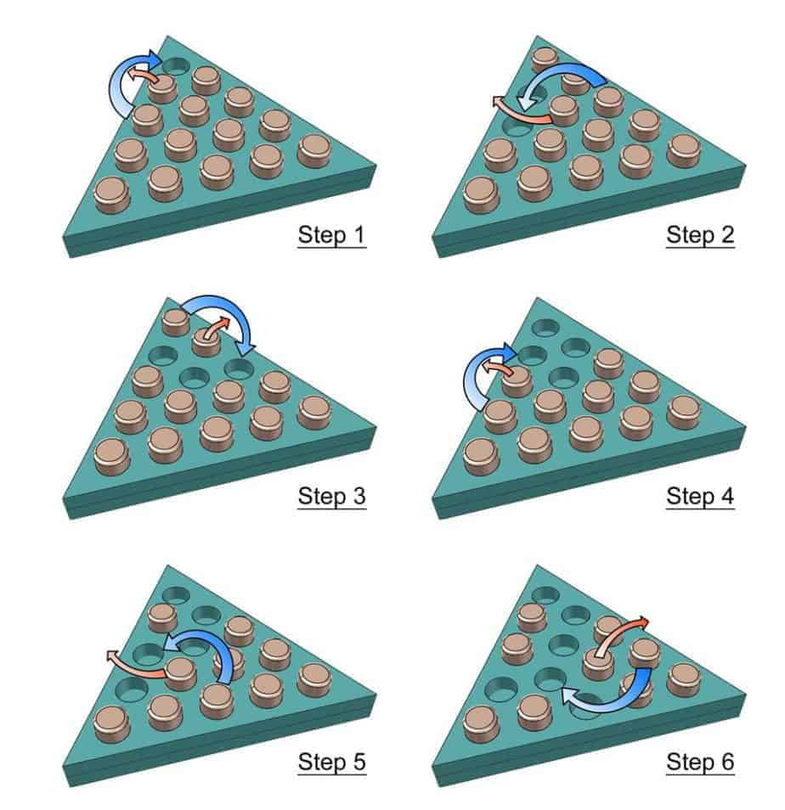
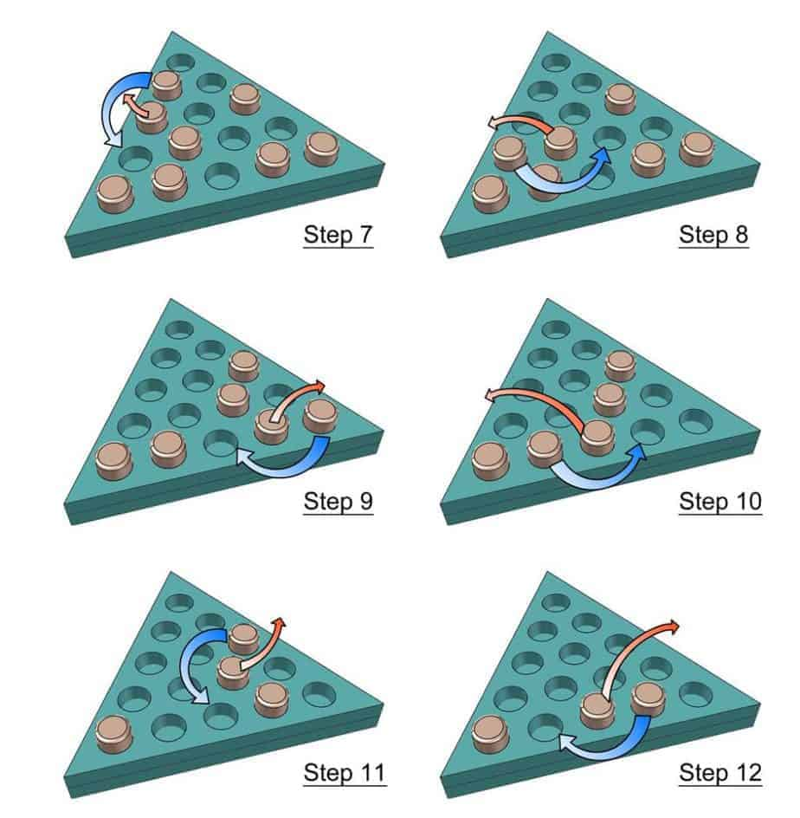
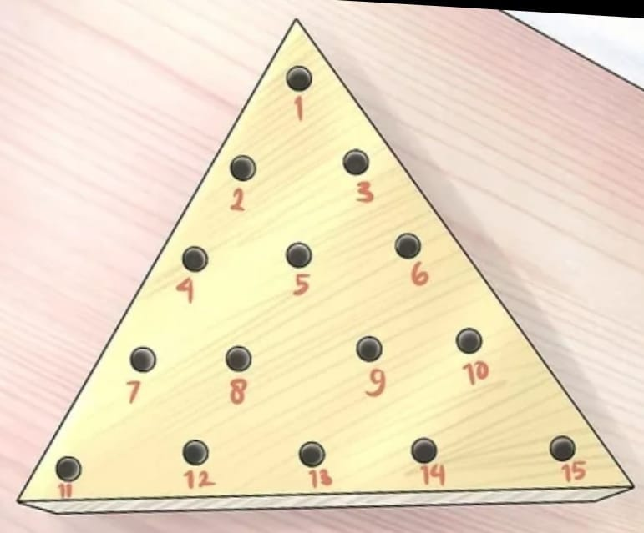
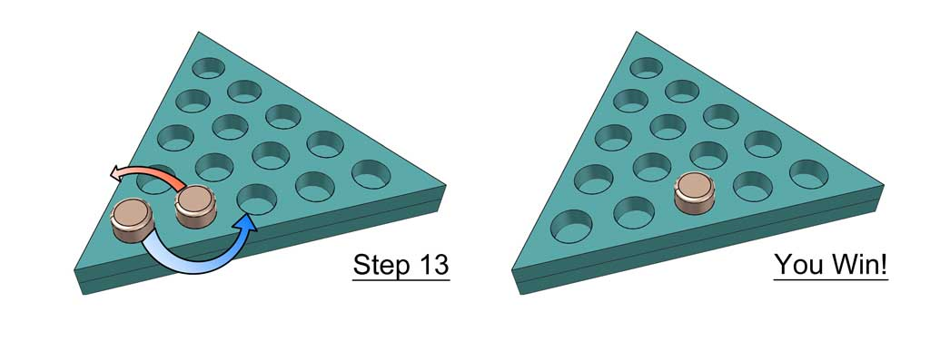
Implementation
04/02/2023
Department of CSE
‹#›

Slide 7
Contribution Of Team
Our team expressed the ideas and had the best discussions sharing our thoughts ideas and opinions helped our project to complete.
Roll number | Contribution
22WH5A0509 | Defining and initializing board
22WH5A0510 | Draw_board() function
22WH5A0511 | How to handle the events
22WH5A0512 | Handle_click()
04/02/2023
Department of CSE
‹#›

Slide 8

Main Window
04/02/2023
Department of CSE
‹#›

Slide 9
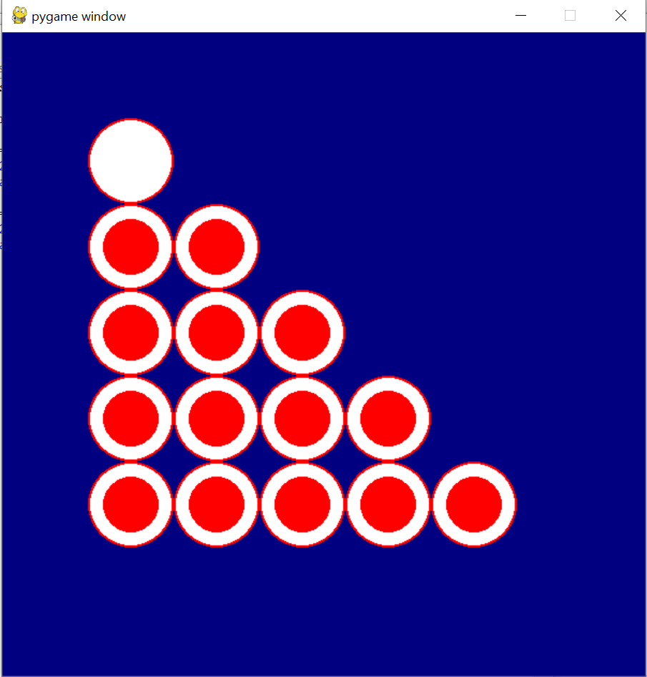
Game Window
04/02/2023
Department of CSE
‹#›

Slide 10
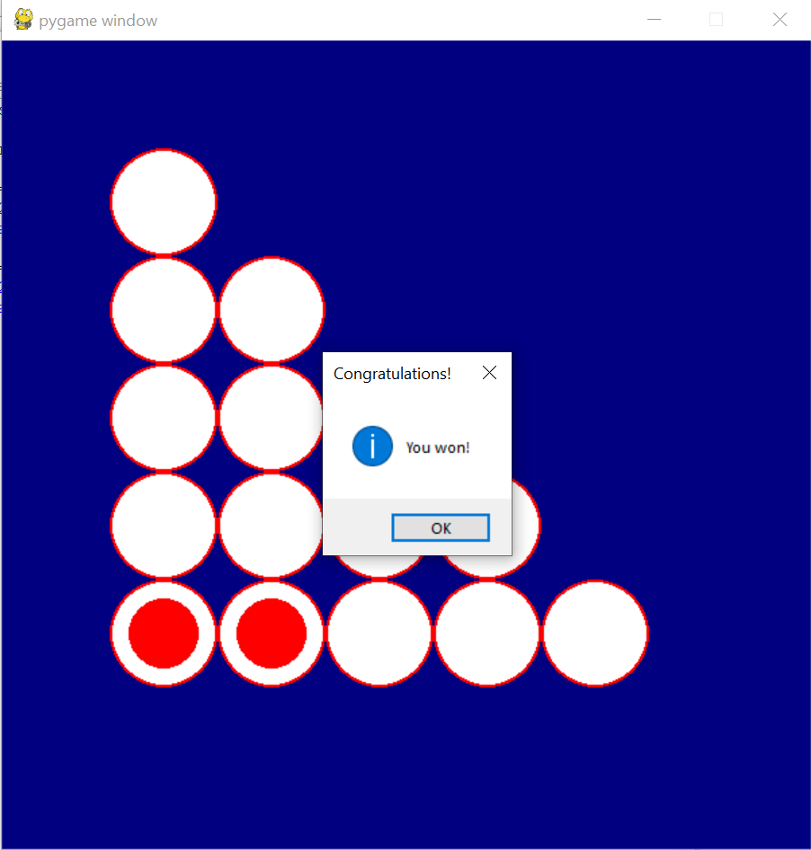
Final Window
04/02/2023
Department of CSE
‹#›

Slide 11
Reference
https://www.wikihow.com/Win-the-Peg-Game
04/02/2023
Department of CSE
‹#›

Slide 12
THANK YOU
Department of CSE
04/02/2023
‹#›

